Slide 1











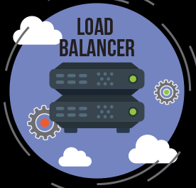


JENKINS PIPELINE
Build and
publish
plugin
Pushes code
Jenkins
Pulls code
Builds
jar
Sonar
Analysis
BDD and TDD
1
2
3
4
6
7
5
Analysis
Results
Build and
publish
Image
To ecr
8
Deploy to
ECS
9
Deploy
image
Load
balancer
Integrate
service
Create
service
Include into
cluster
Container
Task definition
service
14
13
12
11
10

